Slide 1
IMAGE SLOT Genoa / Italian Riviera hero image (airport to supply)
Genoa to New York
A transatlantic opportunity
Aeroporto di Genova Cristoforo Colombo | Genoa - New York | Airbus A321XLR
Route forecast and business case
Prepared by Avia Solutions | June 2026
[ Airport logo ] [ Avia Solutions logo ] [ Airline logo ]

Slide 2
Contents
01
Why New York from Genoa
The largest Italian-American market on earth, a record tourism region, and a major cruise homeport
02
The forecast
The Liguria catchment, the leakage to Milan, and the demand a Genoa nonstop recaptures
03
The case and the precedent
The A321XLR, United's secondary-city template, seasonality, and Genoa airport
Avia Solutions Genoa - New York | Airbus A321XLR
CONTENTS
1

Slide 3
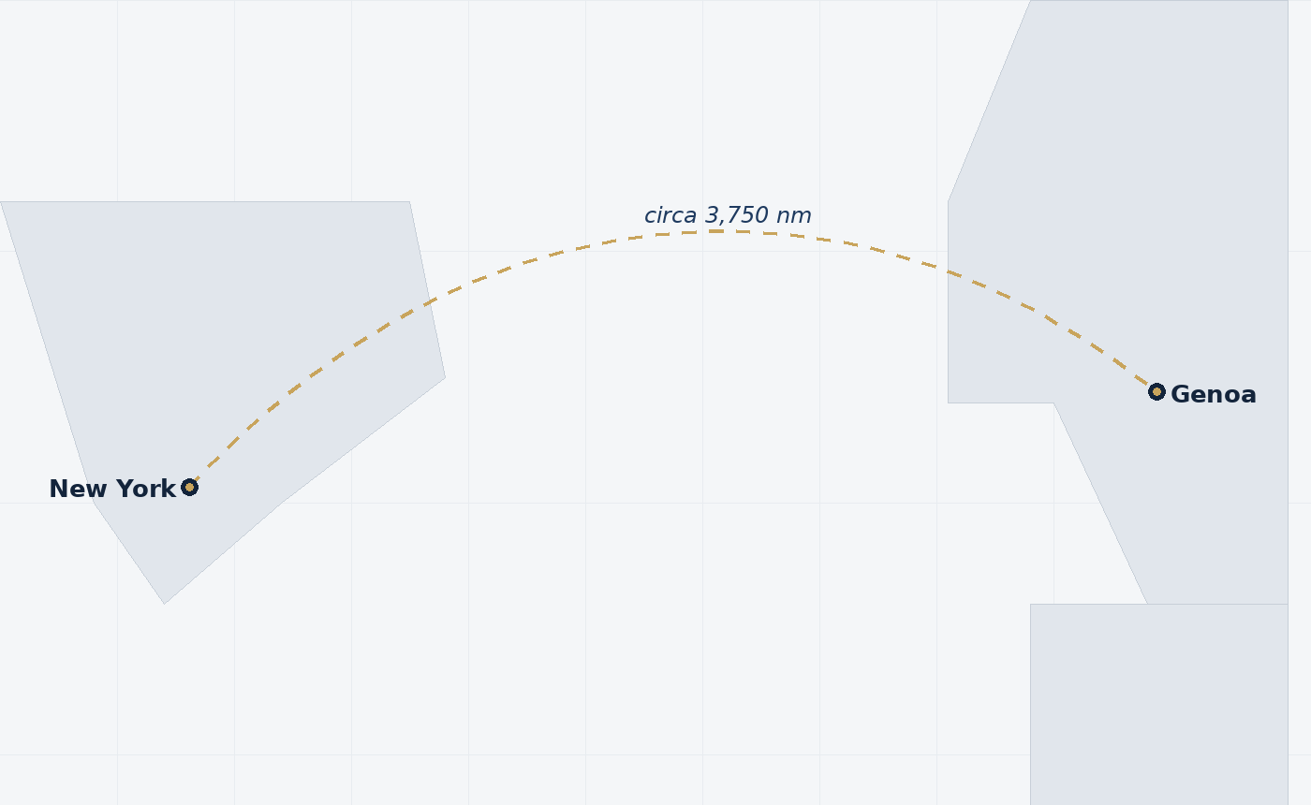
The opportunity
A New York nonstop for Liguria, on a long-range narrowbody
553,300
circa 92,500
circa 0%
New York O&D market
addressable for a nonstop
captured at Genoa today
Annual demand from the Genoa catchment
Demand a Genoa service can serve
Almost all leaks to Milan and Rome
Proposed service
Aircraft | Airbus A321XLR, circa 182 seats (162 economy, 20 business)
Range | Genoa - New York circa 3,750nm, well inside the type's 4,700nm
Natural operator | A Newark-hubbed XLR carrier (United fits the pattern)
Profile | Leisure and visiting-friends led, with a business layer
Sources: Avia QSI catchment and demand model (Sabre O&D), to be refreshed on the live base. Figures illustrative.
Avia Solutions Genoa - New York | Airbus A321XLR
SUMMARY
2

Slide 4
IMAGE SLOT
Genoa old port / Italian Riviera
Airport to supply
01
Why New York
from Genoa
3

Slide 5
The largest Italian-American market on earth
A deep, year-round visiting-friends-and-relatives base
circa 2.6m
circa 6.3m
23.5%
Italians in NY metro
in the US northeast
of US arrivals to Italy
The largest of any US metro
39% of all US Italian-Americans
Come from New York airports alone
The New York region holds the densest Italian-American population anywhere outside Italy. The wider northeast (New York, New Jersey, Connecticut, Massachusetts, Pennsylvania, Rhode Island) accounts for circa 39% of all US Italian-Americans.
This is a resilient, year-round visiting-friends-and-relatives base that is less seasonal and less price-sensitive than pure leisure, and it anchors a US-Italy route at New York specifically.
Genoa carries a direct cultural hook: the city is the birthplace of Christopher Columbus, the airport's namesake and the figure at the centre of New York's Italian-American identity.
Sources: US Census Bureau ACS 2024 (B04006); ENIT / ForwardKeys (Mar 2026). NY metro figure circa 2021 base, to refresh from data.census.gov.
Avia Solutions Genoa - New York | Airbus A321XLR
WHY NEW YORK
4

Slide 6
A record, growing tourism region
Liguria and the Italian Riviera, led by foreign demand
16.2m
Top 10
Best in Travel
Liguria arrivals, 2024
global UNESCO site
Genoa, Lonely Planet 2025
An all-time record, foreign-led growth
Cinque Terre, circa one hour from Genoa
The only Italian city named
Liguria set a tourism record in 2024, with all the growth coming from foreign visitors. Genoa city arrivals reached 4.6m, with foreign arrivals up 5.5%.
The region packs world-class draws within an hour of the airport: the Cinque Terre, Portofino, the Riviera and a UNESCO-listed historic centre.
Genoa's selection as Lonely Planet's only Italian Best in Travel city for 2025 gives the destination fresh, marketable visibility in the US.
Sources: Regione Liguria Tourism Observatory (Feb 2025); Citta della Spezia (Apr 2026); Lonely Planet Best in Travel 2025.
Avia Solutions Genoa - New York | Airbus A321XLR
WHY NEW YORK
5

Slide 7
The premium US to Italy leisure market
High-spend, long-stay, and growing fast
circa 4.1m
+22%
EUR 191
US travellers to Italy
US arrivals, to Aug 2025
US spend per night
Spending over EUR 6.6bn in 2025
Among the fastest-growing US markets
The highest of any nationality
The United States is Italy's premium inbound market: the highest per-night spend of any nationality, long stays of 8 to 10 nights, and a profile that is 88% leisure.
US traffic to Southern Europe is running circa 27% above 2019, against roughly flat growth Europe-wide. Italy is one of the strongest US-Europe markets.
This high-yield, long-stay leisure profile supports a premium cabin and strong ancillary revenue on a Genoa service.
Sources: ENIT on Bank of Italy data (Mar 2026); Bank of Italy Survey on International Tourism 2024; OAG (2024); Italian Ministry of Tourism (Oct 2025).
Avia Solutions Genoa - New York | Airbus A321XLR
WHY NEW YORK
6

Slide 8
A major cruise homeport
Air-relevant embarkation demand on top of the leisure base
Genoa is the seventh-largest cruise port in the Mediterranean, handling circa 1.6m cruise passengers in 2025.
Of these, circa 620,000 are homeport (embarking or disembarking) passengers who must travel to or from Genoa, many by air.
Genoa is the home of Costa Cruises and an MSC base. MSC already sells flight-inclusive packages with a guest lounge at Genoa airport.
The United States is the world's largest cruise source market, so a New York nonstop strengthens Genoa as a transatlantic embarkation port.
circa 620,000
air-relevant cruise pax
Homeport passengers at Genoa, 2025
IMAGE SLOT
Genoa cruise terminal / MSC or Costa ship
Airport to supply
Sources: Risposte Turismo / Seatrade Cruise (Mar 2026); Ports of Genoa; MSC Cruises. Fly-cruise air share to be confirmed from cruise-line data.
Avia Solutions Genoa - New York | Airbus A321XLR
WHY NEW YORK
7

Slide 9
IMAGE SLOT
Liguria map / drive-time to Milan
Airport to supply
02
The forecast
8

Slide 10
The catchment, and the leak to Milan
Genoa's New York demand drives two hours to Malpensa today
The Genoa catchment generates circa 553,300 two-way passengers a year to New York, but almost none of it flies from Genoa.
With no nonstop, Liguria passengers drive circa two hours to Milan Malpensa, or connect over Rome, Munich or Amsterdam.
Milan Malpensa runs circa four daily New York nonstops (Delta, American, Emirates and Neos). That is the pool a Genoa service would partly recapture.
Recapturing local demand onto a local nonstop is the core of the case, the same logic that built United's secondary-Italy routes.
circa 198 km
Genoa to Malpensa
Roughly a two-hour drive each way
circa 4 daily
Milan - New York nonstops
The leakage a Genoa service recaptures
Sources: Avia QSI catchment model; Rome2Rio; OAG / schedule data (Milan-New York frequencies to be confirmed against OAG).
Avia Solutions Genoa - New York | Airbus A321XLR
THE FORECAST
9

Slide 11
Recapturing the leakage: the forecast
What a daily A321XLR can carry
Demand layer | Passengers (each way) | Note
Natural catchment demand to New York | circa 92,500 | Genoa's own addressable market
Captured at Genoa today | circa 7,000 | Almost all leaks to Milan
Leaked pool a nonstop can win | circa 85,500 | Demand driving past Genoa today
Repatriated at 65% capture | circa 55,600 | Bounded, conservative capture
Genoa nonstop forecast | circa 62,600 | Captured plus repatriated
Circa 62,600 each way fills a daily A321XLR (182 seats) in peak season. Capture is bounded at 65% of the leaked pool, so the figure does not over-reach.
Sources: Avia QSI catchment and repatriation model (Sabre O&D), to be refreshed on the live base.
Avia Solutions Genoa - New York | Airbus A321XLR
THE FORECAST
10

Slide 12
Forecast detail
By cabin, with fares and revenue quality
Cabin | Demand (each way) | Share of passengers | One-way fare | Share of revenue
Economy | circa 50,100 | 80% | circa $345 | circa 50%
Business | circa 12,500 | 20% | circa $1,400 | circa 50%
Total each way | circa 62,600 | 100% |  | 100%
circa 125,200
182 seats
circa 90%+
annual passengers
Airbus A321XLR
peak load factor
Both directions combined
162 economy, 20 business
Demand fills the aircraft in season
Business is one in five passengers but circa half of ticket revenue. That revenue quality is what supports a premium single-aisle cabin on the Atlantic.
Sources: Avia QSI revenue model; cabin split and fares from the Genoa case. Illustrative, to be refreshed on the live base.
Avia Solutions Genoa - New York | Airbus A321XLR
THE FORECAST
11

Slide 13
Seasonality
Why a summer-led, building pattern is the prudent launch
Mediterranean leisure demand is highly seasonal, peaking June to September.
The prudent launch mirrors United's secondary-Italy routes: seasonal, late April to October, building frequency.
Year-round service would lean on the visiting-friends and business layers, which are real but thinner.
Sources: Avia QSI model; Eurostat seasonality (2025). Monthly profile illustrative.
Avia Solutions Genoa - New York | Airbus A321XLR
THE FORECAST
12

Slide 14
Capacity and economics
A daily aircraft in peak, with an honest read on the cost base
132,500
circa 62%
Positive
annual seats
breakeven load factor
modest route margin
Daily A321XLR, two-way
Achievable on the demand forecast
At realistic entrant fares
The forecast fills a daily A321XLR through the peak. Demand is concentrated in summer, so a building or seasonal pattern is the prudent launch shape.
At realistic entrant fares (an economy yield set below the market to attract leaked traffic, plus a credible single-aisle business cabin) the route carries a modest positive margin with a breakeven near 62%.
Honest caveat: the cost base is extrapolated for a new-generation narrowbody with no startup ramp modelled. The cost side should be pressure-tested before any commitment.
Sources: Avia QSI revenue and aircraft economics model. Illustrative; pressure-test the cost base before use.
Avia Solutions Genoa - New York | Airbus A321XLR
THE FORECAST
13

Slide 15
IMAGE SLOT
United A321XLR / Newark
Airport to supply
03
The case and
the precedent
14

Slide 16
The A321XLR makes a thin route viable
The aircraft that opens secondary-city transatlantic markets
4,700nm
circa 182
2025-26
A321XLR range
seats
transatlantic entry
Genoa to New York is circa 3,750nm
A fraction of a widebody's demand need
Aer Lingus, Iberia, JetBlue, United
The A321XLR carries circa 180 to 200 passengers across the Atlantic, opening routes that no widebody could fill daily. That is exactly what a thin market like Genoa needs.
Genoa to New York is roughly 3,750nm, comfortably inside the type's 4,700nm range, and Genoa's runway and apron handle the aircraft without constraint.
European carriers are already flying the type transatlantic, and United took its first A321XLR at Newark in June 2026, the natural operator for this route.
Sources: Airbus A321XLR; The Points Guy / Travel And Tour World (Aer Lingus, Iberia, JetBlue); AeroXplorer (United XLR, Jun 2026).
Avia Solutions Genoa - New York | Airbus A321XLR
THE CASE
15

Slide 17
The precedent: United's secondary-Italy nonstops
A proven template Genoa fits precisely
City | Route | Status | Frequency
Naples | Newark, plus Chicago, Atlanta | Established, expanded 2024-2025 | Up to twice daily
Palermo | Newark (United, only US carrier) | Launched May 2025 | 3 weekly, building
Bari | Newark (United, only US carrier) | Launches May 2026 | 4 weekly, Boeing 767
Genoa | New York (proposed) | The opportunity | Seasonal, building
United is systematically opening Newark nonstops from secondary European cities (Palermo, Bari, Glasgow, Bilbao, Split) at 3 to 4 weekly. Genoa is a mid-sized Italian city with strong US leisure demand and no incumbent nonstop: the same case.
Sources: Air Service One (May 2025); AFAR citing United (Oct 2025).
Avia Solutions Genoa - New York | Airbus A321XLR
THE CASE
16

Slide 18
New traffic, and the right service pattern
Stimulation as well as recapture, on a seasonal shape
Stimulation, not only diversion
A seasonal shape is the honest base
Naples is the proof: North American seats reached six times the 2019 level by 2025 as nonstops were added, growth too large to be diversion from Rome or Milan alone.
A Genoa nonstop both recaptures the Liguria leakage to Milan and stimulates new US point-of-sale and inbound leisure demand.
Mediterranean leisure is highly seasonal, so the prudent base case is a service running late April to October, not year-round.
Year-round operation would lean on the visiting-friends and business layers, which are real but thinner. The precedent carriers run these markets seasonally.
Sources: Air Service One (Naples, May 2025); OAG (2024); Eurostat seasonality (2025).
Avia Solutions Genoa - New York | Airbus A321XLR
THE CASE
17

Slide 19
Genoa Cristoforo Colombo airport
Capable, growing fast, and with no long-haul today
1.58m
2,915m
Zero
passengers, 2025
runway
long-haul routes today
A record, up 18% on 2024
Comfortable for an A321XLR to New York
All Liguria long-haul leaks out
Genoa set a passenger record in 2025, up 18% on the year, with international traffic rising for 21 consecutive months. The airport has clear momentum.
The runway and apron handle widebodies for cruise charters, so an A321XLR is well within capability. There is no transatlantic-relevant runway constraint.
The airport is independently operated and is openly pursuing an air-service-development agenda, a receptive counterparty for a new long-haul.
Sources: Invest in Genova citing the airport (Jan 2026); Genoa Cristoforo Colombo airport / SKYbrary (runway).
Avia Solutions Genoa - New York | Airbus A321XLR
THE CASE
18

Slide 20
Genoa airport: the hard facts
From the AIP and airport data, held offline in the tool
ICAO / IATA | LIMJ / GOA
Coordinates | 44.4133 N, 008.8375 E
Elevation | 13 ft (4 m), sea level
Runway | 10/28, 2,915 m x 45 m, asphalt
Approach | ILS, precision approach
Aircraft stands | 32, of which 6 widebody-capable
2025 passengers | 1.58m, a record (+18%)
Distance to city | circa 6 km to Genoa centre
Suitable for the route
An A321XLR to New York needs circa 2,100 to 2,600 m at maximum take-off weight. Genoa's 2,915 m runway at sea level gives ample margin.
IMAGE SLOT
Genoa airport / airfield aerial
Airport to supply
Sources: Genoa AIP (LIMJ) / airport data held offline; Invest in Genova (2025 traffic). Single-runway, no parallel - flag for resilience.
Avia Solutions Genoa - New York | Airbus A321XLR
THE CASE
19

Slide 21
The business layer
Modest but real, on top of the leisure and diaspora base
Liguria has an affluent, export-facing economy (GDP per head above the national average) anchored by the Port of Genoa, Italy's premier gateway port at circa 3.0m TEU in 2025.
Genoa-headquartered industrials with global travel needs include Ansaldo Energia, Hitachi Rail and Esaote, alongside major Leonardo and Fincantieri sites in the region.
The Italian Institute of Technology, headquartered in Genoa, runs permanent research outstations in the United States, generating recurring transatlantic academic travel.
Italy-US goods and services trade reached circa $137.6bn in 2024, with New York the institutional hub for Italian business in the US.
Kept in proportion
Genoa's specific corporate links to New York are modest. The route is carried by leisure, the diaspora and cruise demand, with business a supporting layer, not the headline.
Sources: ISTAT (2024); Ports of Genoa (2025); IIT Facts and Figures (Apr 2026); US Department of Commerce / ITA (Feb 2026).
Avia Solutions Genoa - New York | Airbus A321XLR
THE CASE
20

Slide 22
Methodology: the Avia QSI approach
The same engine, tuned to this route's profile
1
Catchment
2
Demand and repatriation
Drive-time analysis sets Genoa's natural share of the Liguria market and the leakage to Milan, Rome and other gateways.
Sabre O&D sizes the New York market; a bounded capture of the leaked pool gives the demand a nonstop recaptures.
3
Service and economics
4
Category research
The A321XLR is matched to demand, with revenue by cabin, fares, and aircraft operating economics for the route P&L.
The relevance engine selects what matters for this profile: leisure, diaspora, cruise and the precedent, not corporate and tech.
Data sources: Sabre O&D demand and OAG schedules. The category research is prioritised automatically by route profile.
Avia Solutions Genoa - New York | Airbus A321XLR
THE CASE
21

Slide 23
A New York nonstop for Liguria
The largest Italian-American market in the world, a record tourism region and a major cruise homeport, with circa 92,500 New York passengers a year leaking out through Milan. The A321XLR and United's secondary-city template make Genoa the next in line.
Avia Solutions
Route development and air service consultancy
john.carter@aviasolutions.com
22

